Slide 1


Workshop on evaluating vaccine impact Evaluating Vaccine Impact using Time Series Data
Dan Weinberger, PhD
Epidemiology of Microbial Diseases
Yale School of Public Health

Slide 2
Acknowledgements
The development of this workshop was supported by a grant from the Bill and Melinda Gates Foundation
The material in this workshop was jointly developed with
Dr. Kayoko Shioda (Yale/Emory)
Iris Artin
Dr Cristiana Toscano (PAHO/Universidade Federal de Goiás)
Dr. Lucia Oliveria (PAHO)
Dr. Jackie Kleynhans (NICD/South Africa)
Dr. Nuredin Mohammed (MRC/Gambia)
Dr. Lone Simonsen (Roskilde)
Dr. Rob Taylor (Sage Analytica)
Dr. Cynthia Schuck-Paim (Sage Analytica)
Dr. Christian Bruhn
The WHO working group on the use of administrative data to evaluate PCV impact (Fernanda Lessa (CDC), Jennifer Loo Farrar (CDC), Tomoka Nakamura (WHO), Adam Cohen (WHO/CDC)

Slide 3
Conflicts of interest
I am PI on grants from Merck and Pfizer to Yale
I consult for Pfizer, Merck, GSK, Affinivax and Matrivax, all of whom are producing or developing pneumococcal vaccines

Slide 4
In this presentation
What do we mean by ‘vaccine impact’?
What are some common data sources that can be used,
Administrative data and its pitfalls?

Slide 5
Types of studies to evaluate vaccines using real-world data
Evaluating direct effect of a vaccine
on an individual’s risk of disease
A: Case, unvaccinated
Case-control studies (also: test negative case-control)
V
B: Case, vaccinated
V
V
V
C: Control, unvaccinated
V
V
V
D: Control, vaccinated
V
V
V
Vaccine effectiveness: 100* (1-(B/A)/(D/C))
Vaccine effectiveness: 100* (1-(3/4)/(5/2))=70%

Slide 6
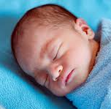
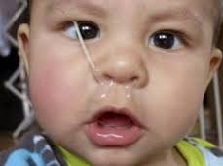

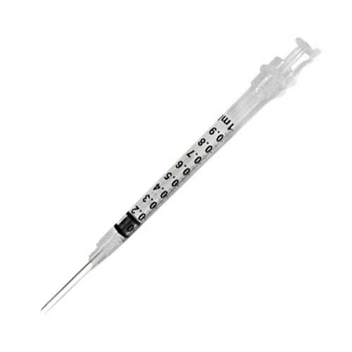
Quantifying the impact of vaccines
For many vaccines, the public health benefit depends on both the direct effect and indirect effect that results from blocking transmission
To quantify this total benefit of the vaccine we need to evaluate changes in aggregate rates of disease that occur after vaccine introduction
Vaccine impact= direct+indirect effects of the vaccines
To do this, we perform time series analysis to quantify declines in disease rates following introduction of vaccine
http://theroadtodomestication.com/wp-content/uploads/2015/07/IMG_6746-1565.jpg
https://i2.wp.com/www.lifewithgremlins.com/wp-content/uploads/2014/07/holy-snot.jpg?zoom=2.625&fit=570%2C363&ssl=1&resize=166%2C95

Slide 7
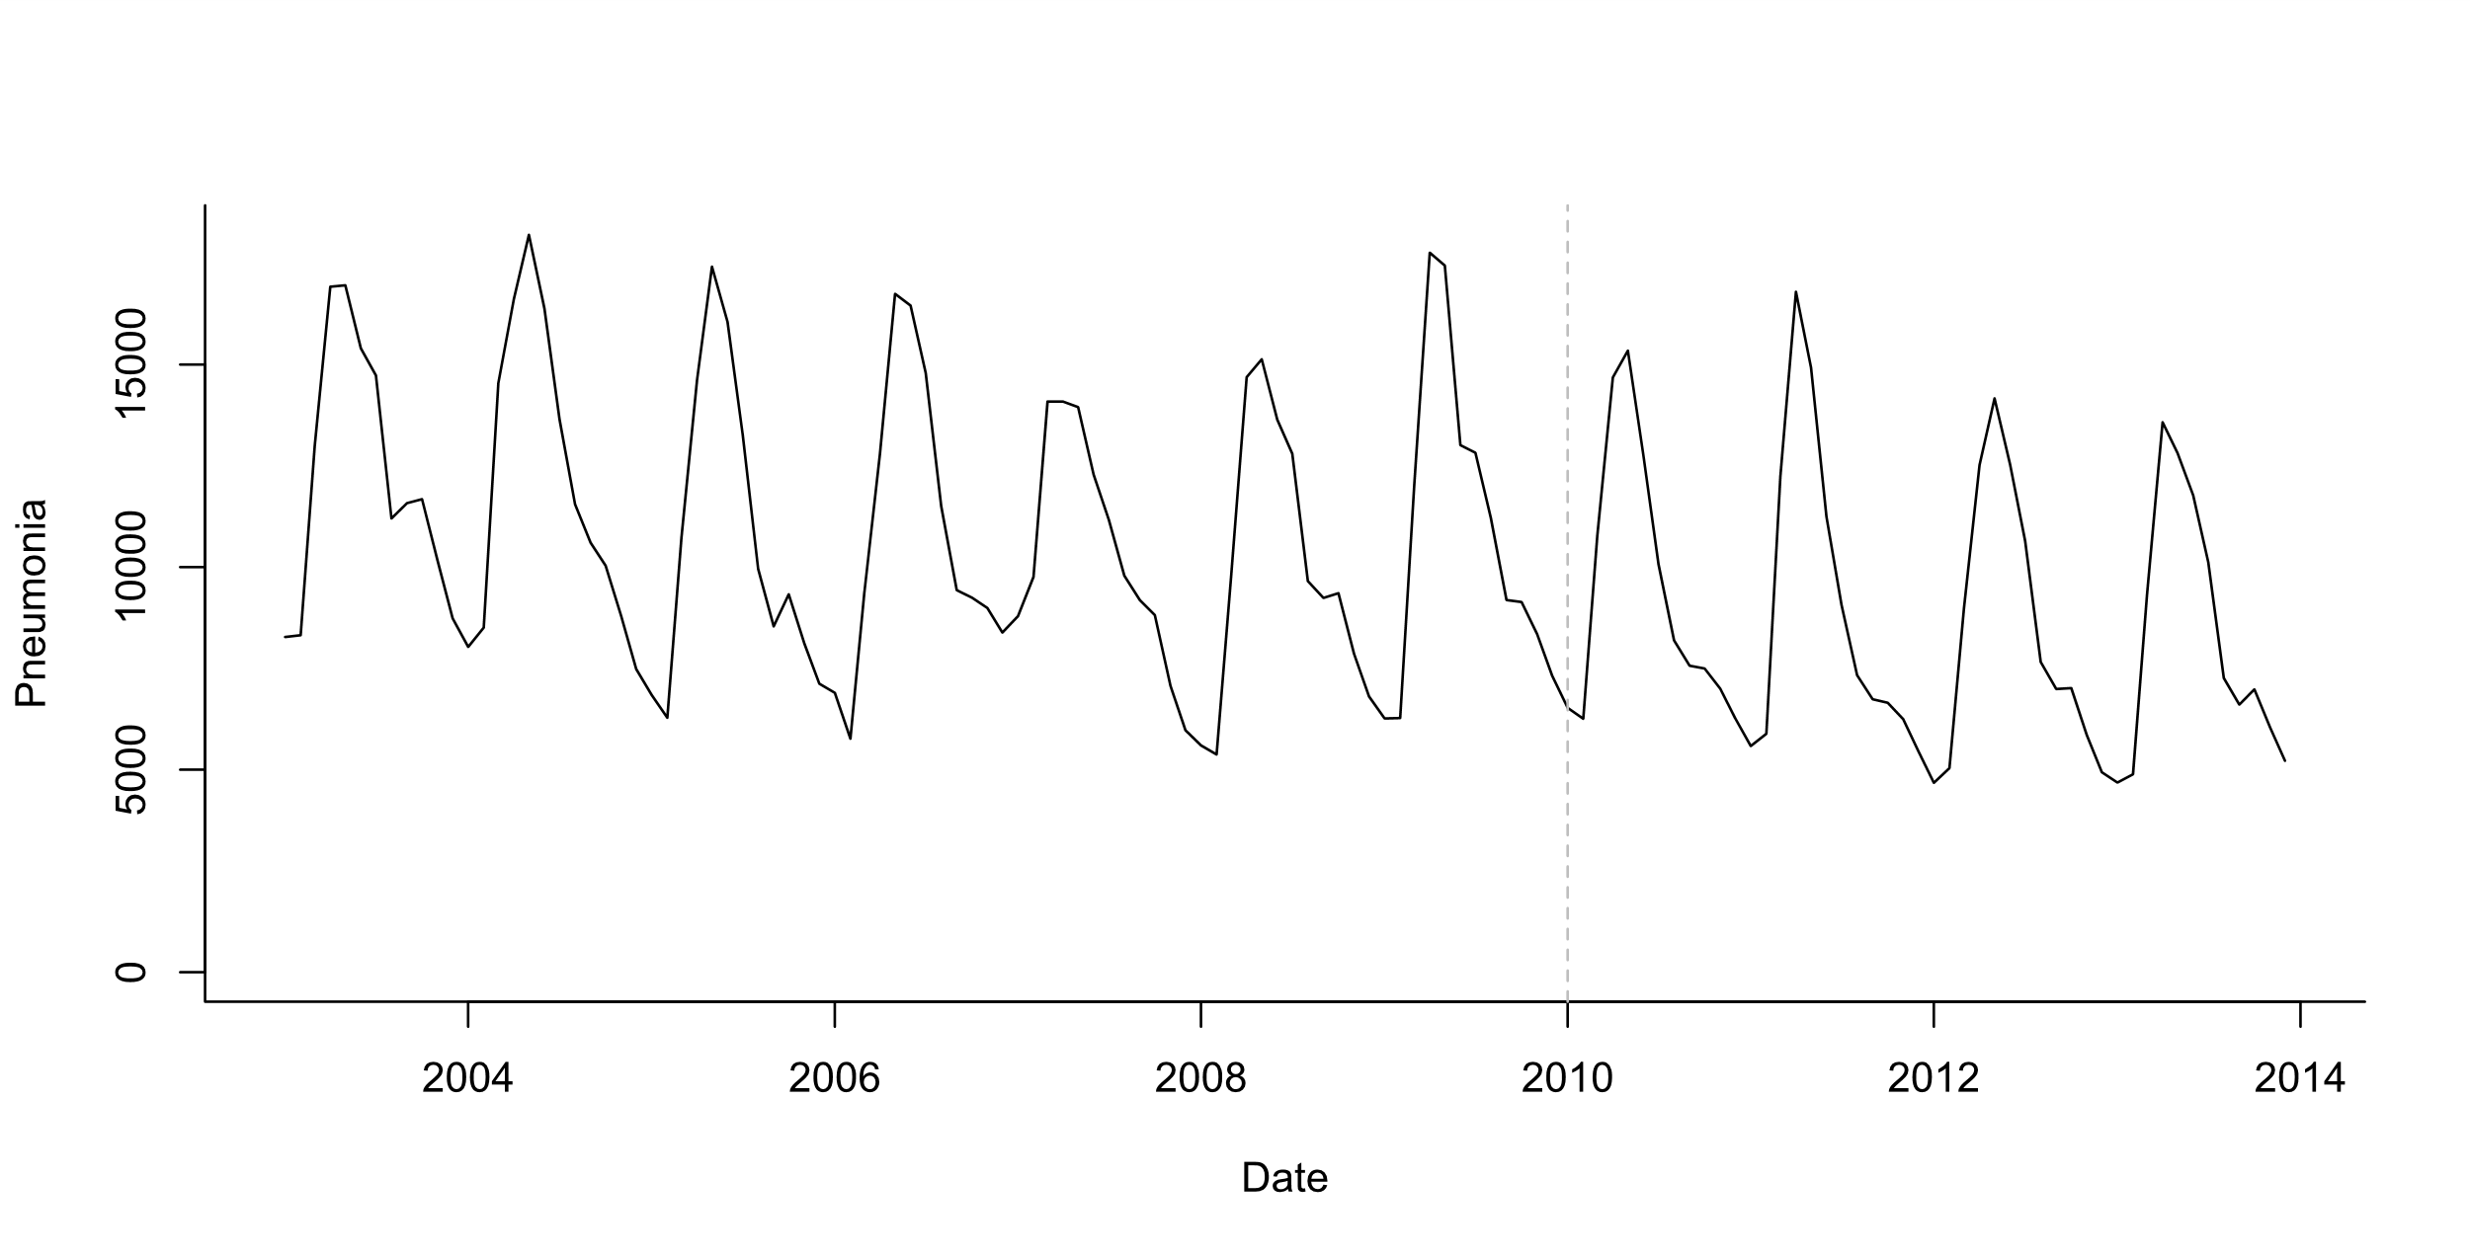
What is a time series?
Number of cases per week/month/year
A monthly time series of pneumonia cases in infants in Brazil
Number of events
Time (in months)

Slide 8
Simple case: is there a change following vaccine introduction?
A monthly time series of pneumonia cases in infants in Brazil
Number of events
Is there a decline?
Time (in months)

Slide 9
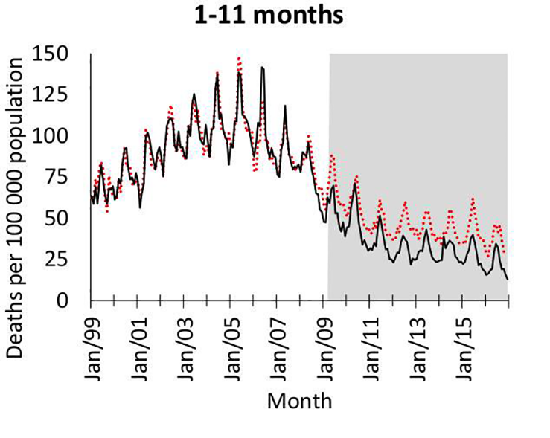
What could go wrong?
Pneumonia deaths in S. Africa
Changes in diagnostic/referral patterns that coincide with vaccine introduction
Changes in underlying health of the population that coincide with vaccine introduction
Unexplained linear and non-linear trends
Non-endemic diseases with unpredictable dynamics (e.g., COVID-19)
Kleynhans, et al PLOS Medicine

Slide 10
What else could go wrong with analyses?
Epidemic before or after vaccine introduction (biases slope estimates)
Ie 2009 pandemic, then introduce PCV in 2010
Insufficient data in pre- or post-period to accurately estimate trend
Delayed rollout of vaccine/low uptake
Many, many other issues that you can’t predict…

Slide 11
Defining the study question: PICO
P - the target population in which the impact of the intervention is to be measured
I - the intervention and date of intervention
C - the comparator (disease or group of diseases to which the outcome will be compared with), which is not expected to be impacted by the intervention
O - the outcome of interest, i.e., what is the condition being evaluated that is expected to be impacted by the intervention

Slide 12
Defining the study question: PICO
P - the target population Children 2-59 months in Brazil
I - the intervention Introduction of PCV10 in the national immunization program in 2010
C - the comparator To be discussed…
O - the outcome of interest Deaths due to pneumonia
And what data sources do we have to evaluate these questions?

Slide 13
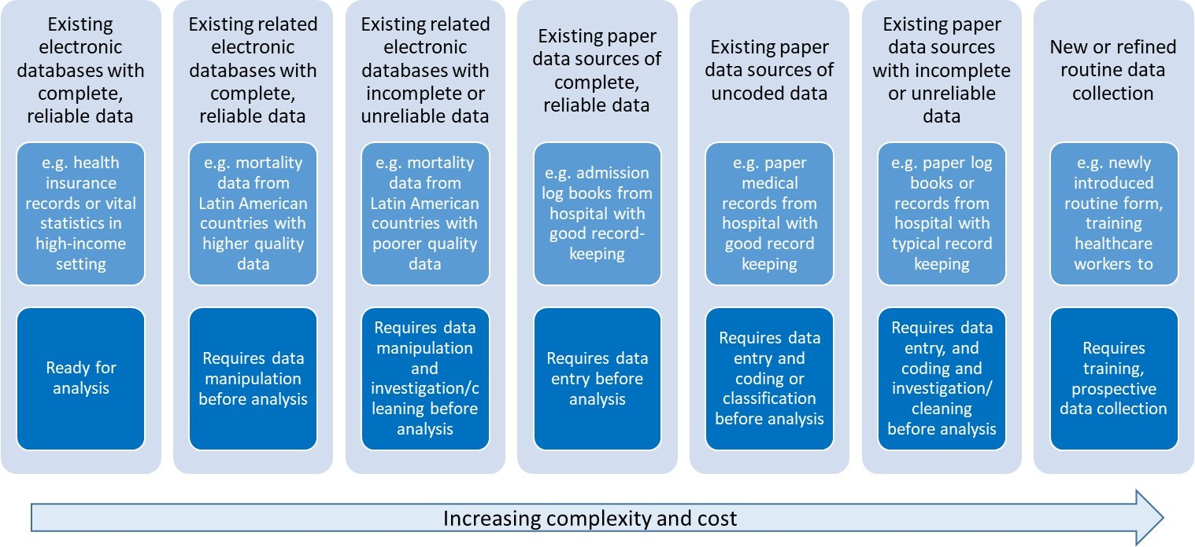
Types of data for evaluating vaccine impact
Jennifer Verani, Centers for Disease Control and Prevention – Kenya, slideset on “Using administrative data to measure PCV impact in Africa”

Slide 14
Common types of administrative data
National mortality registries
Hospital discharge data from a single hospital/region/nation
Insurance claims databases

Slide 15
Typical structure of administrative datasets
Age (y) | Date of admission | Region of residence | Cause 1 | Cause2…
3.2 | 2019-01-02 | NW | J129
1.5 | 2019-01-15 | NW | E101 | J189
7 | 2019-11-01 | S | J18
9 | 2019-12-01 | MW | J14
11 | 2019-12-15 | E | J13

Slide 16
Common issues with administrative data
Simple pre/post vaccine comparisons to evaluate importance of different potential biases
Use Brazil healthcare system as a test case

Slide 17
Denominators/offsets
Commonly defined as number of cases per capita (incidence)
N_cases/N_people*100,000
But often database doesn’t cover all of the population
Coverage might change over time
Might want to use:
Number of people using healthcare system
Number of people who are hospitalized
Number of people receiving some test (e.g., Xrays)
Population size
Number of hospitalizations
Hospitalization/Population

Slide 18
Effect of denominator on estimates
~70% of Brazilian population uses public healthcare (SUS)
Varies by region and declines over time

Slide 19
Denominators
Choose a denominator that reflects changes in potential confounders
Change in all-cause pneumonia 2011-12 vs 2008-09 when using different denominators
 | Total population | Population using public system | All-cause hospitalization
Brazil | .89 | .92 | 0.85

Slide 20
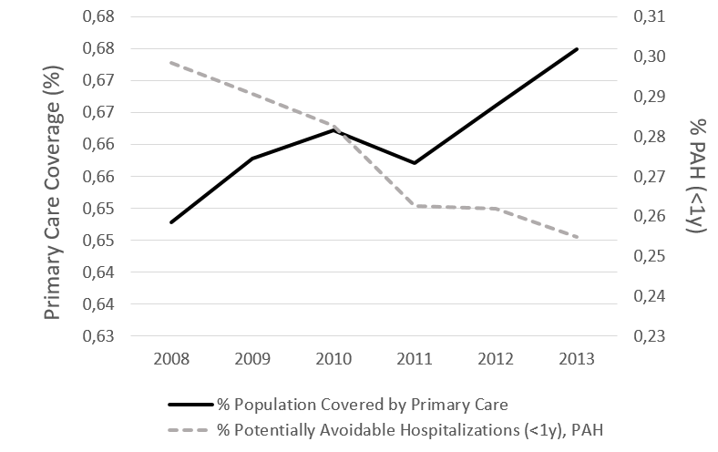
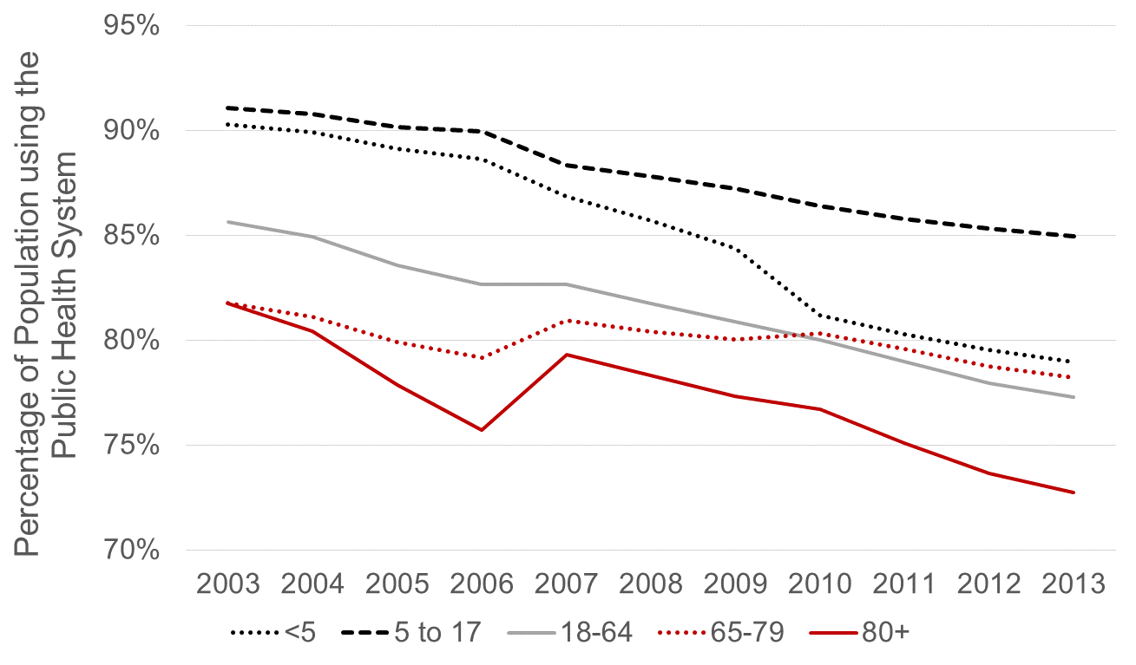
Many factors aside from vaccination can influence disease rates
Changes in access to primary care
Changes in use of public healthcare
Potentially-avoidable hospitalizations

Slide 21
Effect of improvements in primary care

Slide 22
Availability of hospital beds

Slide 23
Availability in hospital beds
More consistent (credible?) estimates

Slide 24
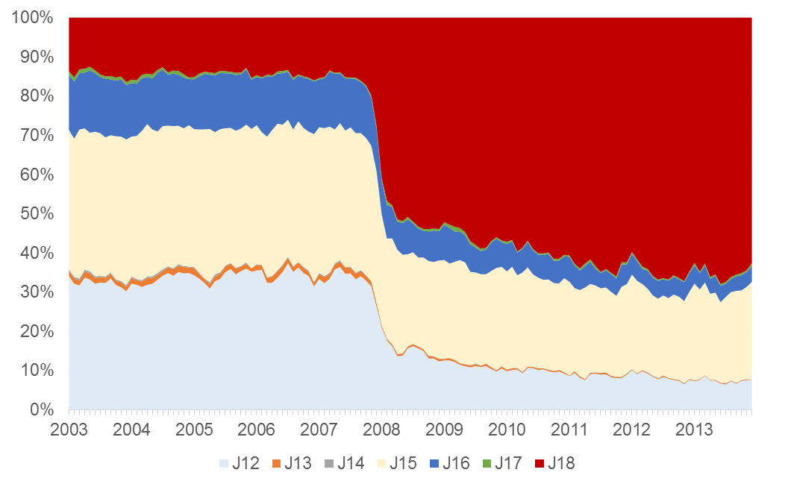
Changes in ICD coding practices
Changes in ICD coding
Pneumonia, unspecified

Slide 25
We have all of these problems with the data, now what?
Identify appropriate variables to control and adjust for these trends unrelated to the vaccine so that we can quantify the
effect of the vaccine

Slide 26
Summary
The goal in evaluations of ‘vaccine impact’ is to measure changes in rates of disease/death associated with vaccine introduction that reflect both direct and indirect effects of vaccines
Administrative data sources are commonly used for this type of analysis
Many things aside from vaccines can influence disease rates and we need tools to isolate the effect of the vaccine

Slide 27
Next up: Practical session 1: Data wrangling
How do we go from a raw line list of data from an administrative dataset to a clean time series using R?

Slide 29
In this video
Trend analysis and building simple regression models
Interrupted time series analysis
How much data do you need to do this type of analysis?

Slide 30
How much does the rate of cases or deaths decline following vaccine introduction?

Slide 31

Estimating the effect of vaccine
Vaccine intro
“Counterfactual”
Vaccine effect
Pre-vaccine
Post-vaccine

Slide 32
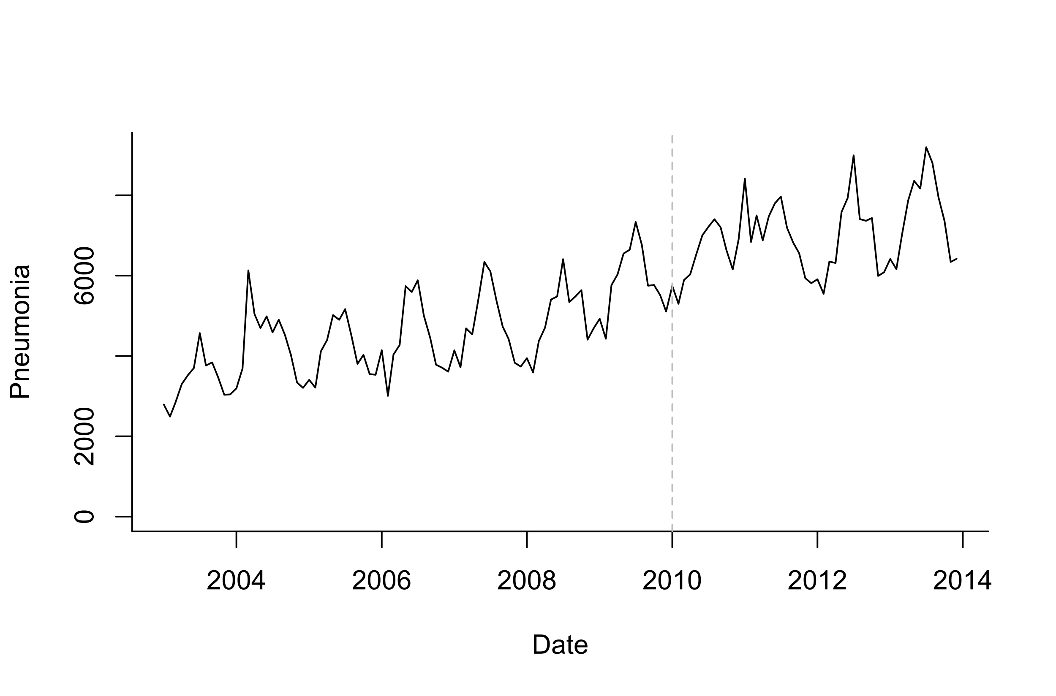
Estimating the effect of vaccine
?
Vaccine effect?
Pre-vaccine
Post-vaccine

Slide 33
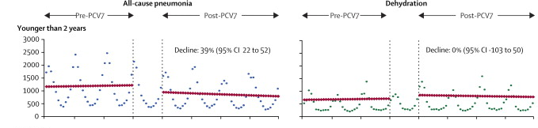
Example: Evaluating the impact of vaccines from time series
Counterfactual
Grijalva et al, The Lancet 2006
Pneumonia declines 39% compared to what would have been expected if not vaccine was introduced

Slide 34
Simple trend analysis
Fit a regression model (Poisson regression or negative binomial regression) to data from the pre-vaccine period
Extrapolate the model to the post-vaccine period (Counterfactual)
Compare the observed data and counterfactual estimates

Slide 35
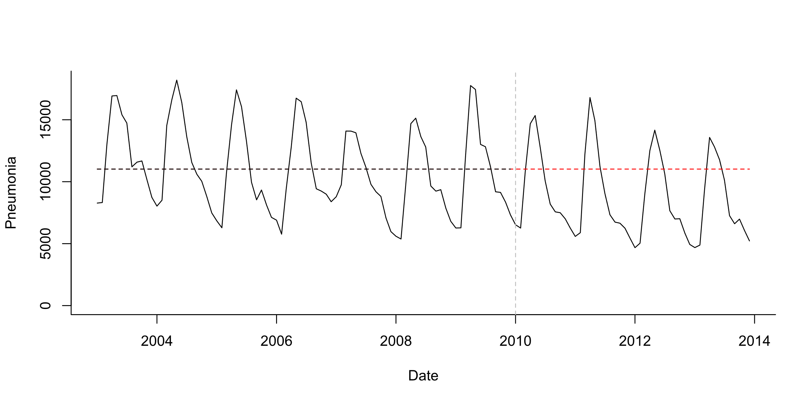
Pre-post analysis
Simple model:
Cases ~ Poisson (lambda)
Log(lambda)=b0
Simplest case: stationary data ; no trends, no seasonality
Test whether mean number of cases declines post-PCV

Slide 36
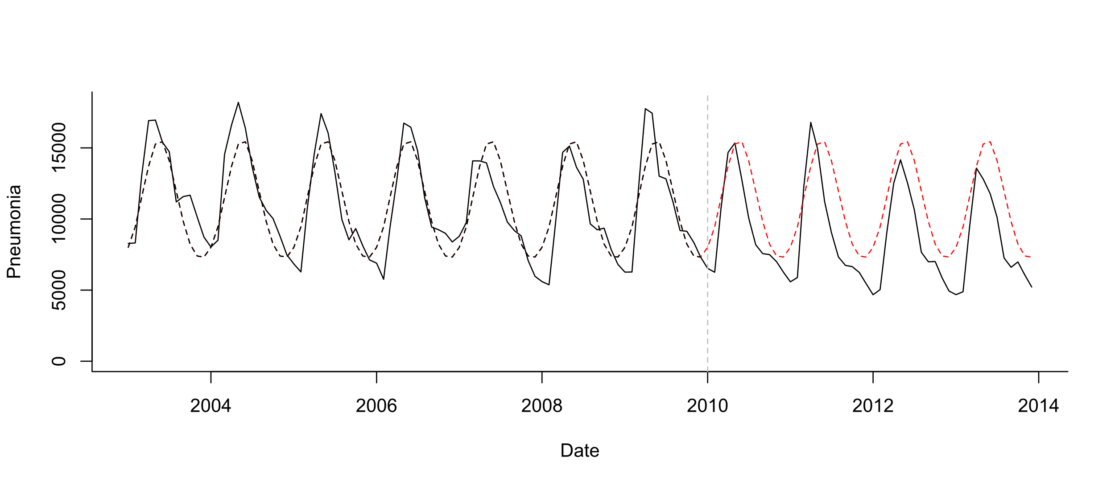
Pre-post analysis+seasonality
Seasonal model:
Cases ~ Poisson (lambda)
Log(lambda)=b0 +b1*sin12 +b2*cos12
Test whether mean number of cases declines post-PCV

Slide 37
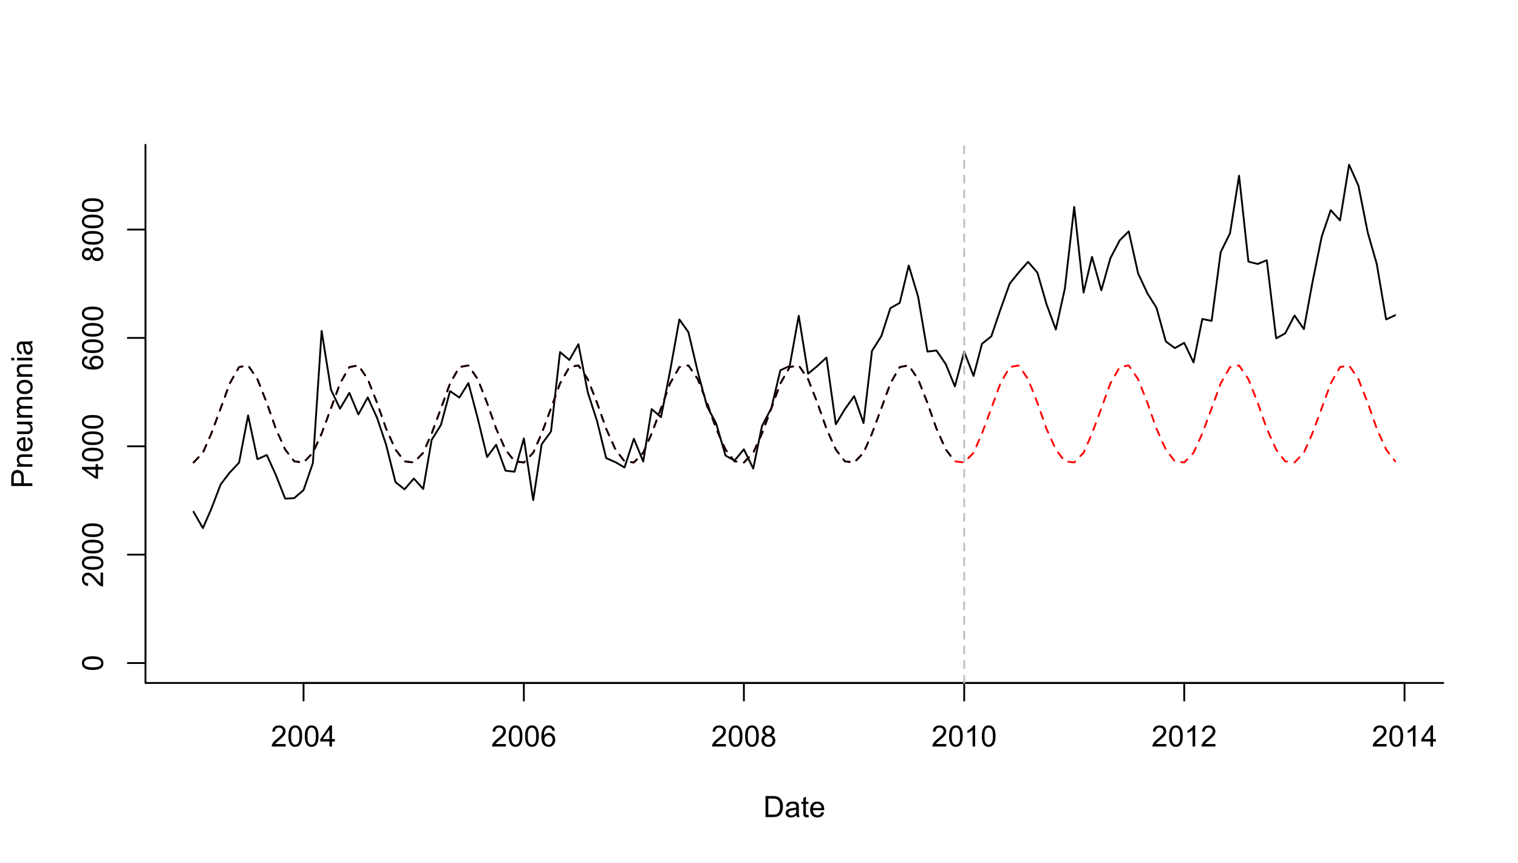
Pre-post analysis+seasonality
Seasonal model:
Cases ~ Poisson (lambda)
Log(lambda)=b0 +b1*sin12 +b2*cos12
Test whether mean number of cases declines post-PCV

Slide 38
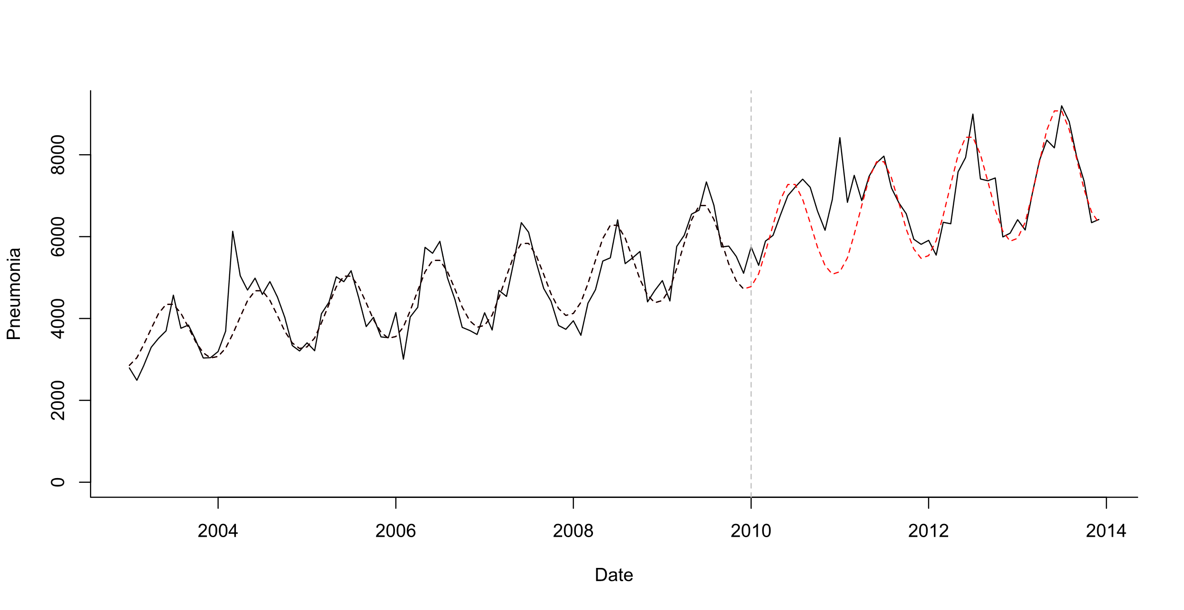
Pre-post analysis+seasonality + linear trend
Test whether mean number of cases declines post-PCV
Seasonal model:
Cases ~ Poisson (lambda)
Log(lambda)=b0 +b1*sin12 +b2*cos12 +b3*trend
What is your evaluation period?
Last 2 years? Last 3 years?

Slide 39
Interrupted time series analysis
Broad group of approaches
Fit regression model to entire time series and allow the slope of the line and the average number of cases (level) to change after vaccination
Can explicitly quantify how the vaccine effects the slope and level
Can generate counterfactuals by pretending the slope and level changes did not occur
Need to make or test assumptions about the timing of the decline and its shape (e.g., step change)

Slide 40
Interrupted time series (ITS)
Change in level postvaccine
Pre-vaccine slope
Change in slope postvaccine
Yt=exp(b+ a*t + c*z + d*t*z)

Slide 41
Interrupted time series (ITS)
Does slope significantly change at time q
Predicted value at time t: Yt=exp(b+ a*t + c*z + d*t*z)
Counterfactual at time t: Yt=exp(b+a*t)
Difference or ratio between observed and counterfactual lines gives the “Vaccine impact” (rate ratio or rate difference)

Slide 42
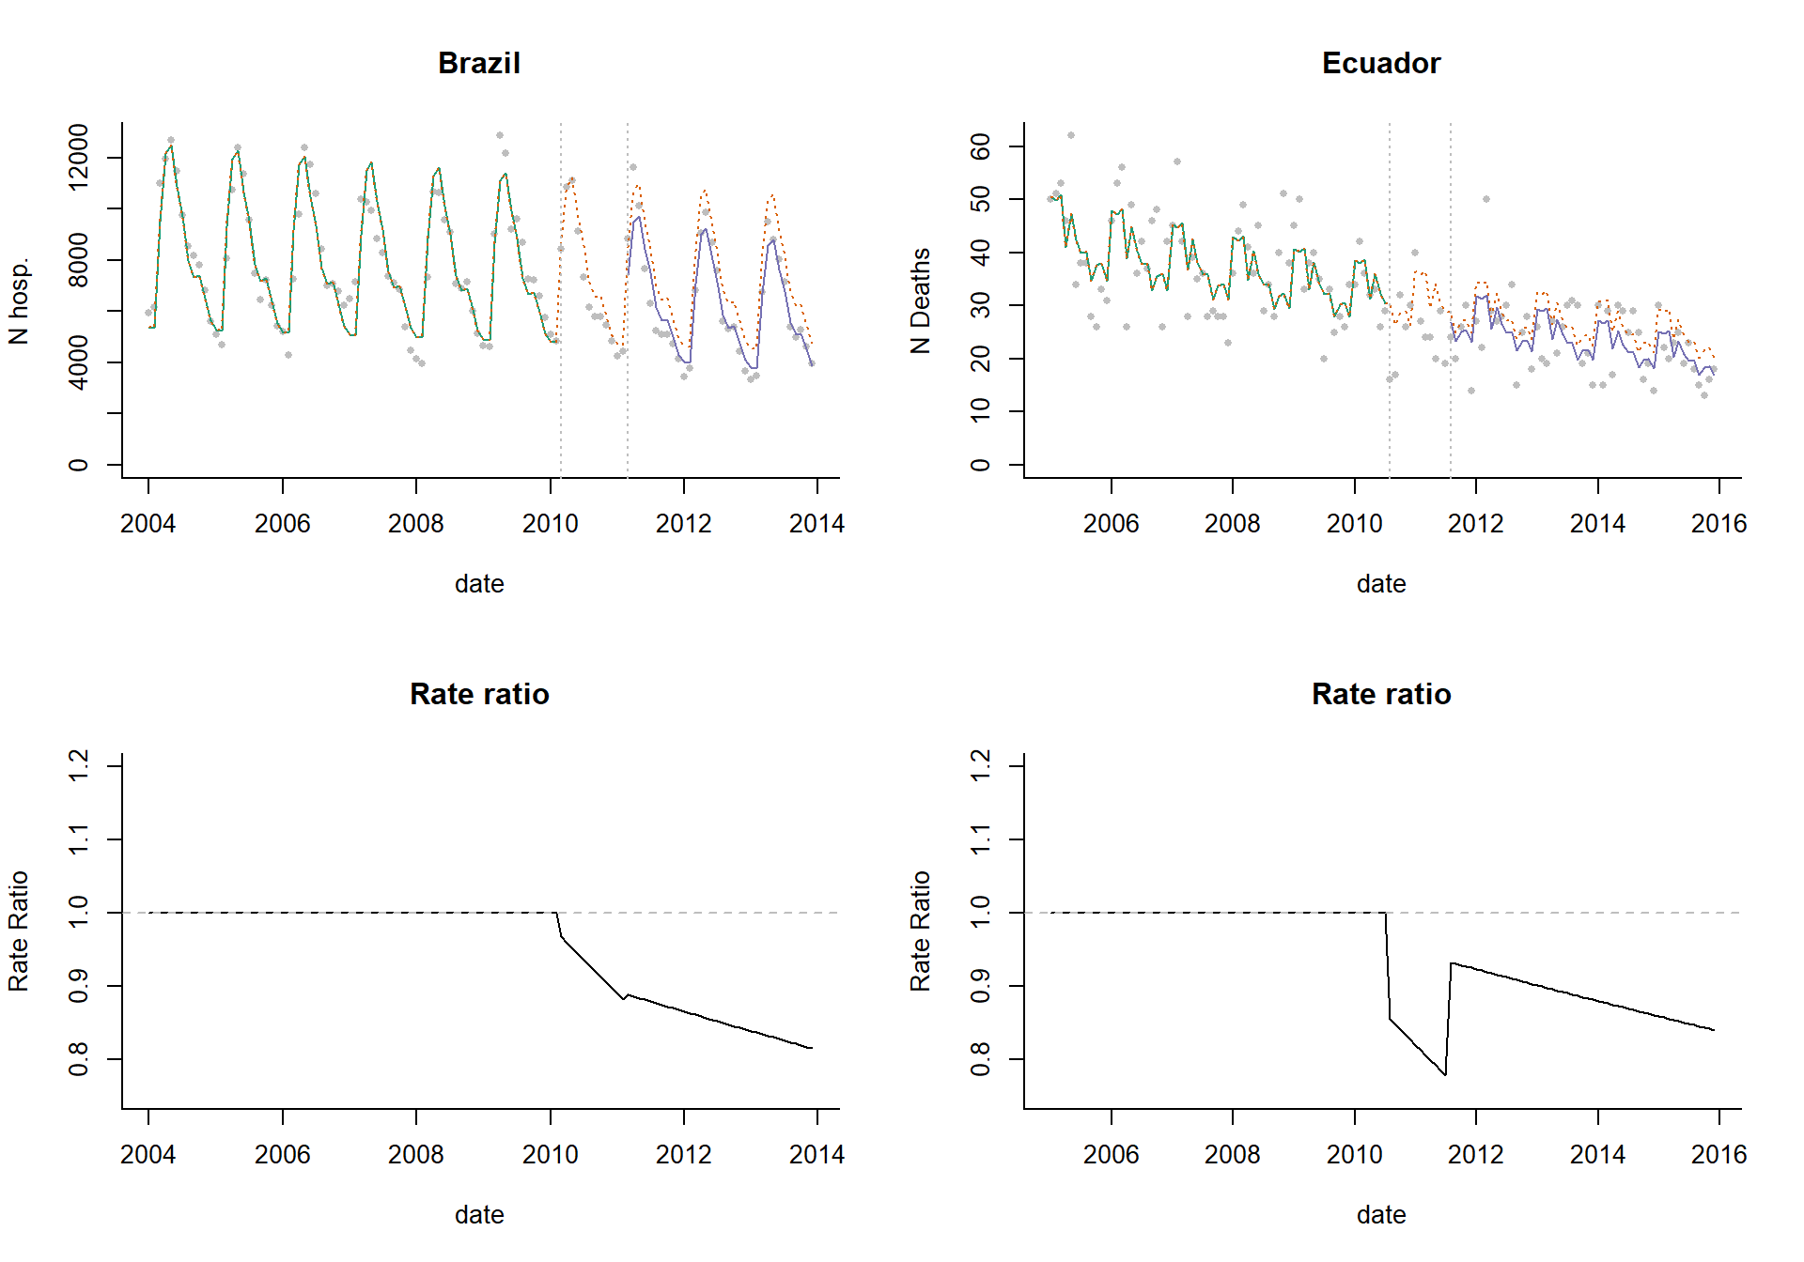
Disjointed ITS
No requirement that the different segments connect

Slide 43
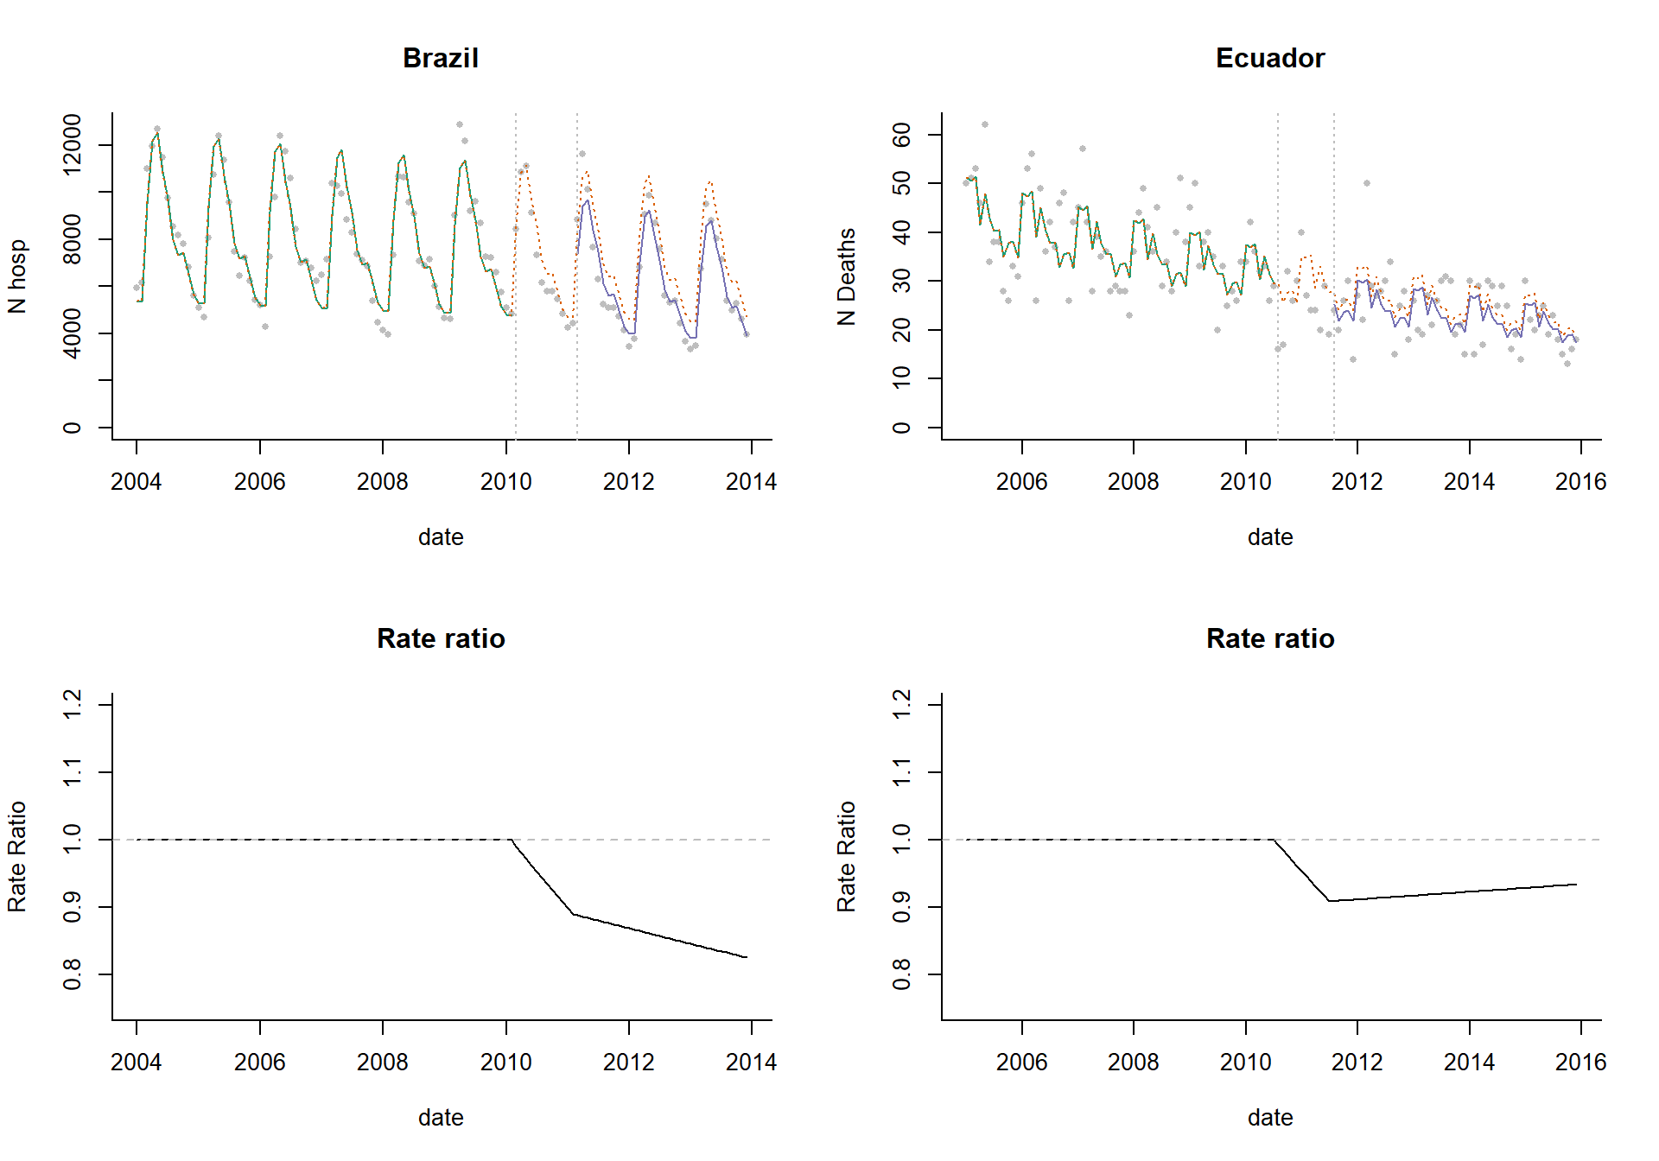
ITS with connected segments
Requires the segments to connect

Slide 44
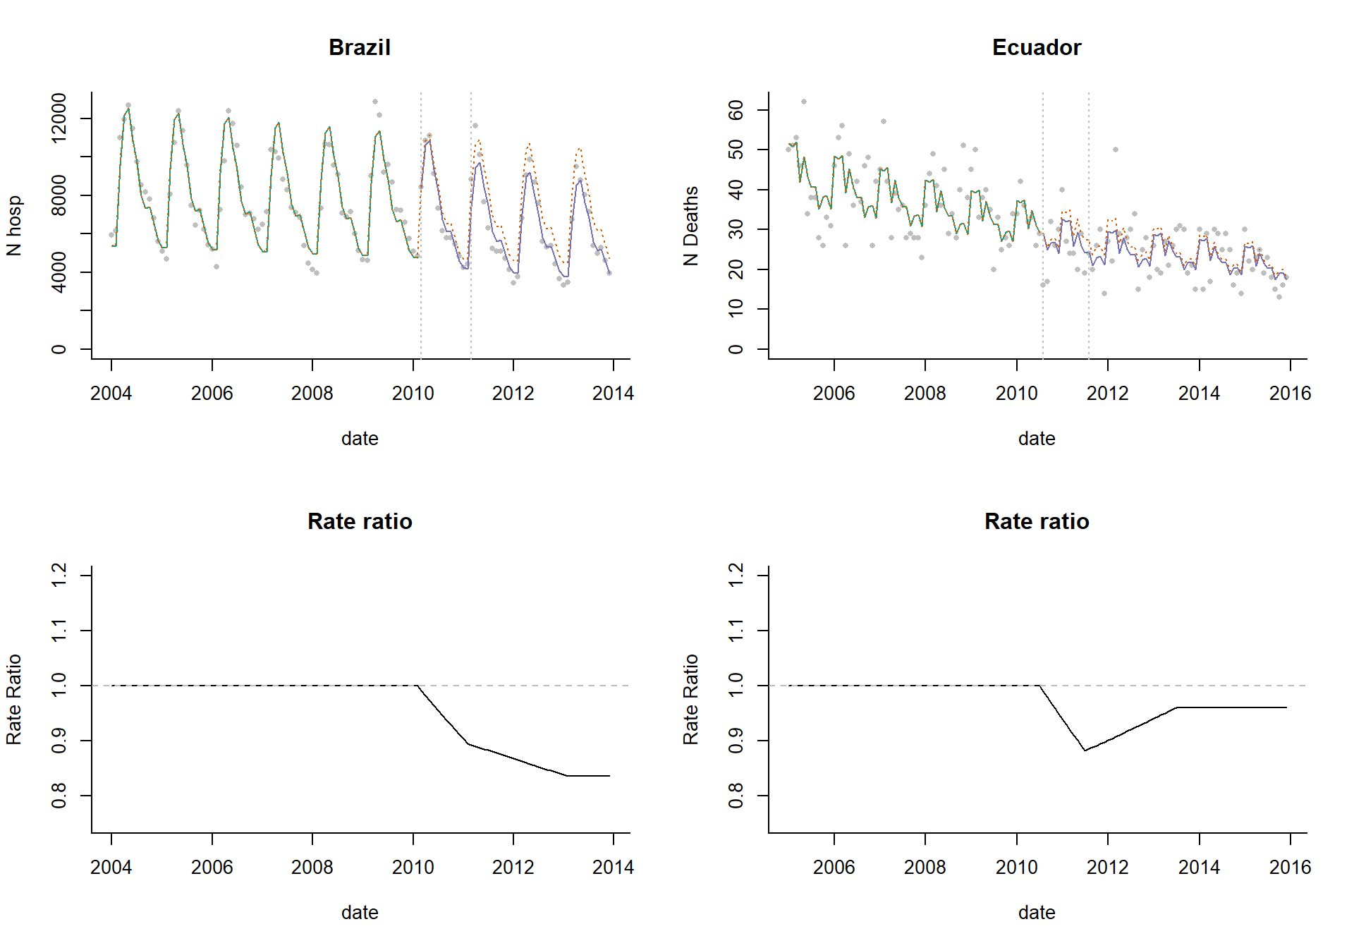
ITS with leveling of the slope
Requires segments to be connected, and assumes changes will stabilize after a specified amount of time

Slide 45
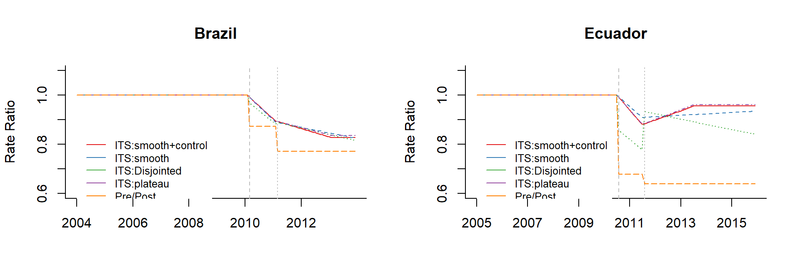
How much do these different assumptions matter?
-It depends on the dataset
-Pre/post is almost always wrong

Slide 46
Steps for evaluating performing interrupted time series analysis
Define “baseline”, transition periods
Determine whether there are any trends or patterns in the baseline period
Seasonality, etc
Fit a model to your baseline data using regression
Be wary of over-fitting (use AIC)
Evaluate model parameters
Compare fitted with counterfactual values to estimate impact
THINK ABOUT WHAT COULD GO WRONG:
Identify controls!
Do sensitivity analyses!
i.e., leave out one season at a time; try different intervention times

Slide 47
Sensitivity analyses you should consider
Never trust your main analyses without “pressure testing” it
Try different intervention dates—how does it influence your estimate?
Leaving out different seasons when fitting, see if it changes the answer

Slide 48
How much data do you need for a trend analysis?

Slide 49
Ability to detect a vaccine-associated decline
Depends on:
Size of the expected decline (ie a 40% decline is easier to see than a 10% decline)
Amount of unexplained variability in the data

Slide 50
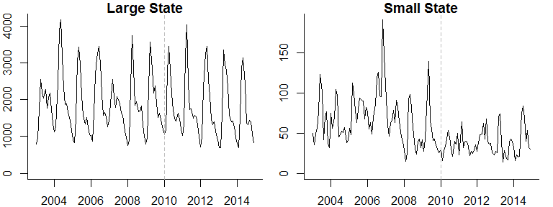
Pneumonia hospitalizations (N)

Slide 51
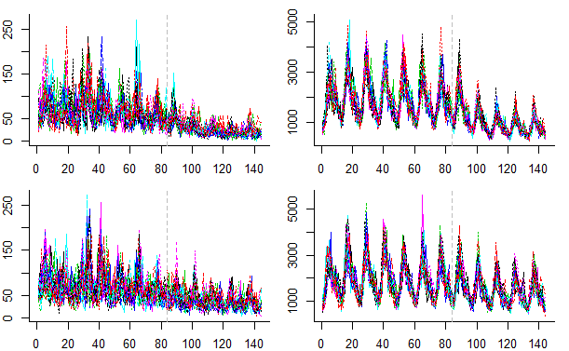
Simulated time series for a large and small state
20 Simulated time series for a small state
20 Simulated time series for a large state
50% reduction
20% reduction
https://weinbergerlab.shinyapps.io/ITS_Poisson_Power/

Slide 52
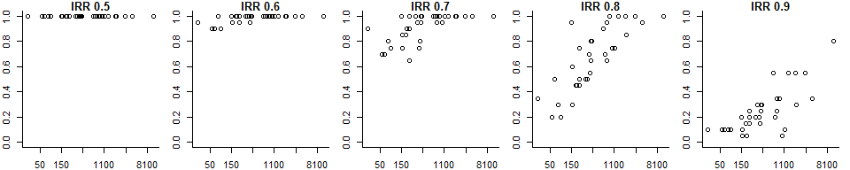
Power to detect a vaccine effect
Each dot on the plots below represents 1 of the 27 states
Each plot represents a different expected vaccine effect
Power: Percent of the simulations for which 95% CI for the rate ratio does not include 1
Expected vaccine effect (IRR)
Power
Average cases/month pre-PCV
With a smaller vaccine effect, only large states have adequate power
With a strong vaccine effect, even small states have excellent power to correctly detect the effect
All-cause pneumonia studies somewhere around here

Slide 53
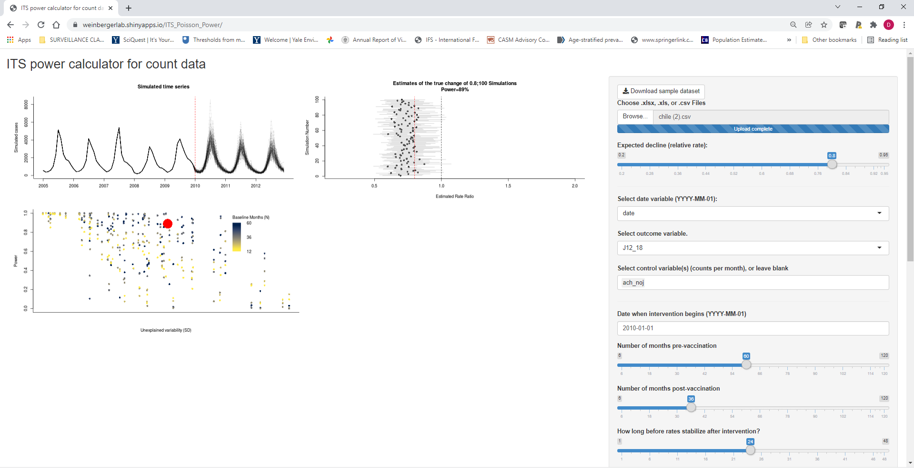
Perform simulations to see how likely it is that you would detect a decline
https://weinbergerlab.shinyapps.io/ITS_Poisson_Power/

Slide 54
Summary
Interrupted time series use linear trends to adjust for factors unrelated to vaccinations and to measure changes in the frequency of disease that occurs after vaccine introduction
The accuracy of these estimates and ability to measure it depends on the expected size of the decline and the amount of unexplained variation (noise) in the data
Typically have more noise in datasets from smaller populations

Slide 55
What else could go wrong with analyses?
Epidemic before or after vaccine introduction (biases slope estimates)
Ie 2009 pandemic, then introduce PCV in 2010
Insufficient data in pre- or post-period to accurately estimate trend
Unrelated changes that coincide with vaccine introduction
Delayed rollout of vaccine/low uptake
Many, many other issues that you can’t predict…

Slide 56
Up next: live sessions
1) Introduction to interrupted time series methods in R
2) Case study on evaluating the impact of PCVs in The Gambia, using R

Slide 58

Yale
Workshop on evaluating vaccine impact
Use of controls to improve estimates of vaccine impact
Dan Weinberger, PhD
Associate Professor
Yale School of Public Health

Slide 59
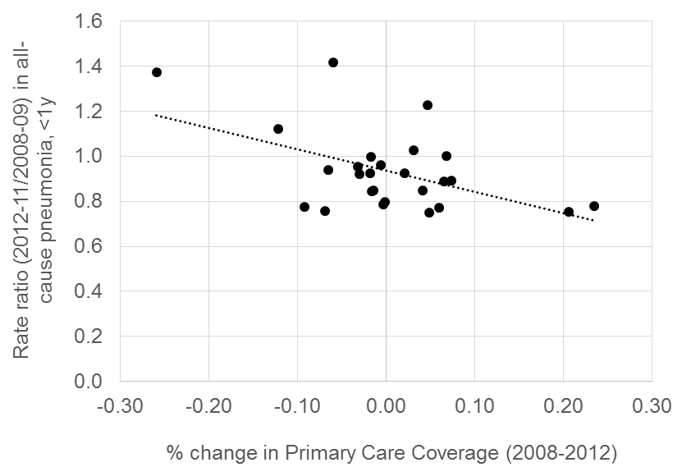
Issues that can affect reported rates from administrative data
Changes in access to primary care
Changes in ICD coding
Pneumonia, unspecified
Potentially-avoidable hospitalizations
Changes in use of public healthcare

Slide 60
Motivating example: PCVs in S Africa
Pneumonia deaths in S. Africa
HIV/AIDS
HAART
PCVs
Kleynhans, et al PLOS Medicine

Slide 61
Ways to use control diseases
As a comparison
As an adjustment variable
Grijalva et al, The Lancet 2006

Slide 62
Use control diseases as a comparison
Vaccine
Often used qualitatively
“Pneumonia declines but UTI is stable”
Can be used quantitatively
“Effect of PCV against pneumonia is X%-Y%”
Pneumonia
X% decline
Pre-vaccine
Post-vaccine
Time
Y% decline
Control disease
(e.g.UTI)
Pre-vaccine
Post-vaccine
Time

Slide 63
Use control disease as an adjustment variable
Control disease
Model fit
Pneumonia
Pre-vaccine
Post-vaccine
Time
Step 1: Fit a regression model using data from the pre-vaccine data to establish a
relationship between pneumonia and a control disease
E.g., log(pneumonia)= b0 + b1*log(control disease)

Slide 64
How does it work?
Control disease
Model fit
Pneumonia
Pre-vaccine
Post-vaccine
Time
Step 2: Plug in observed values for control disease from post-vaccine period to get an estimate for what counts of pneumonia would be

Slide 65
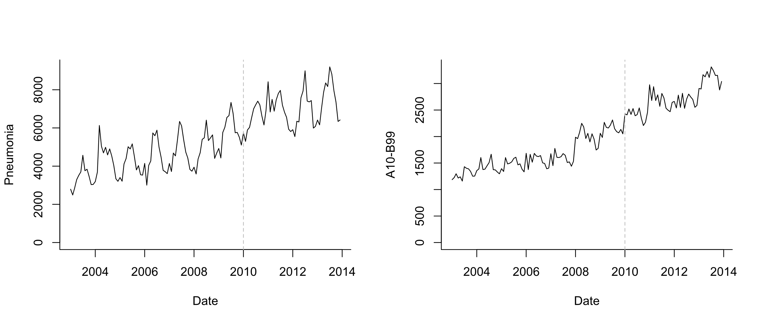
Use control disease as an adjustment variable
Infectious causes (exclude J codes, diarrhea)

Slide 66
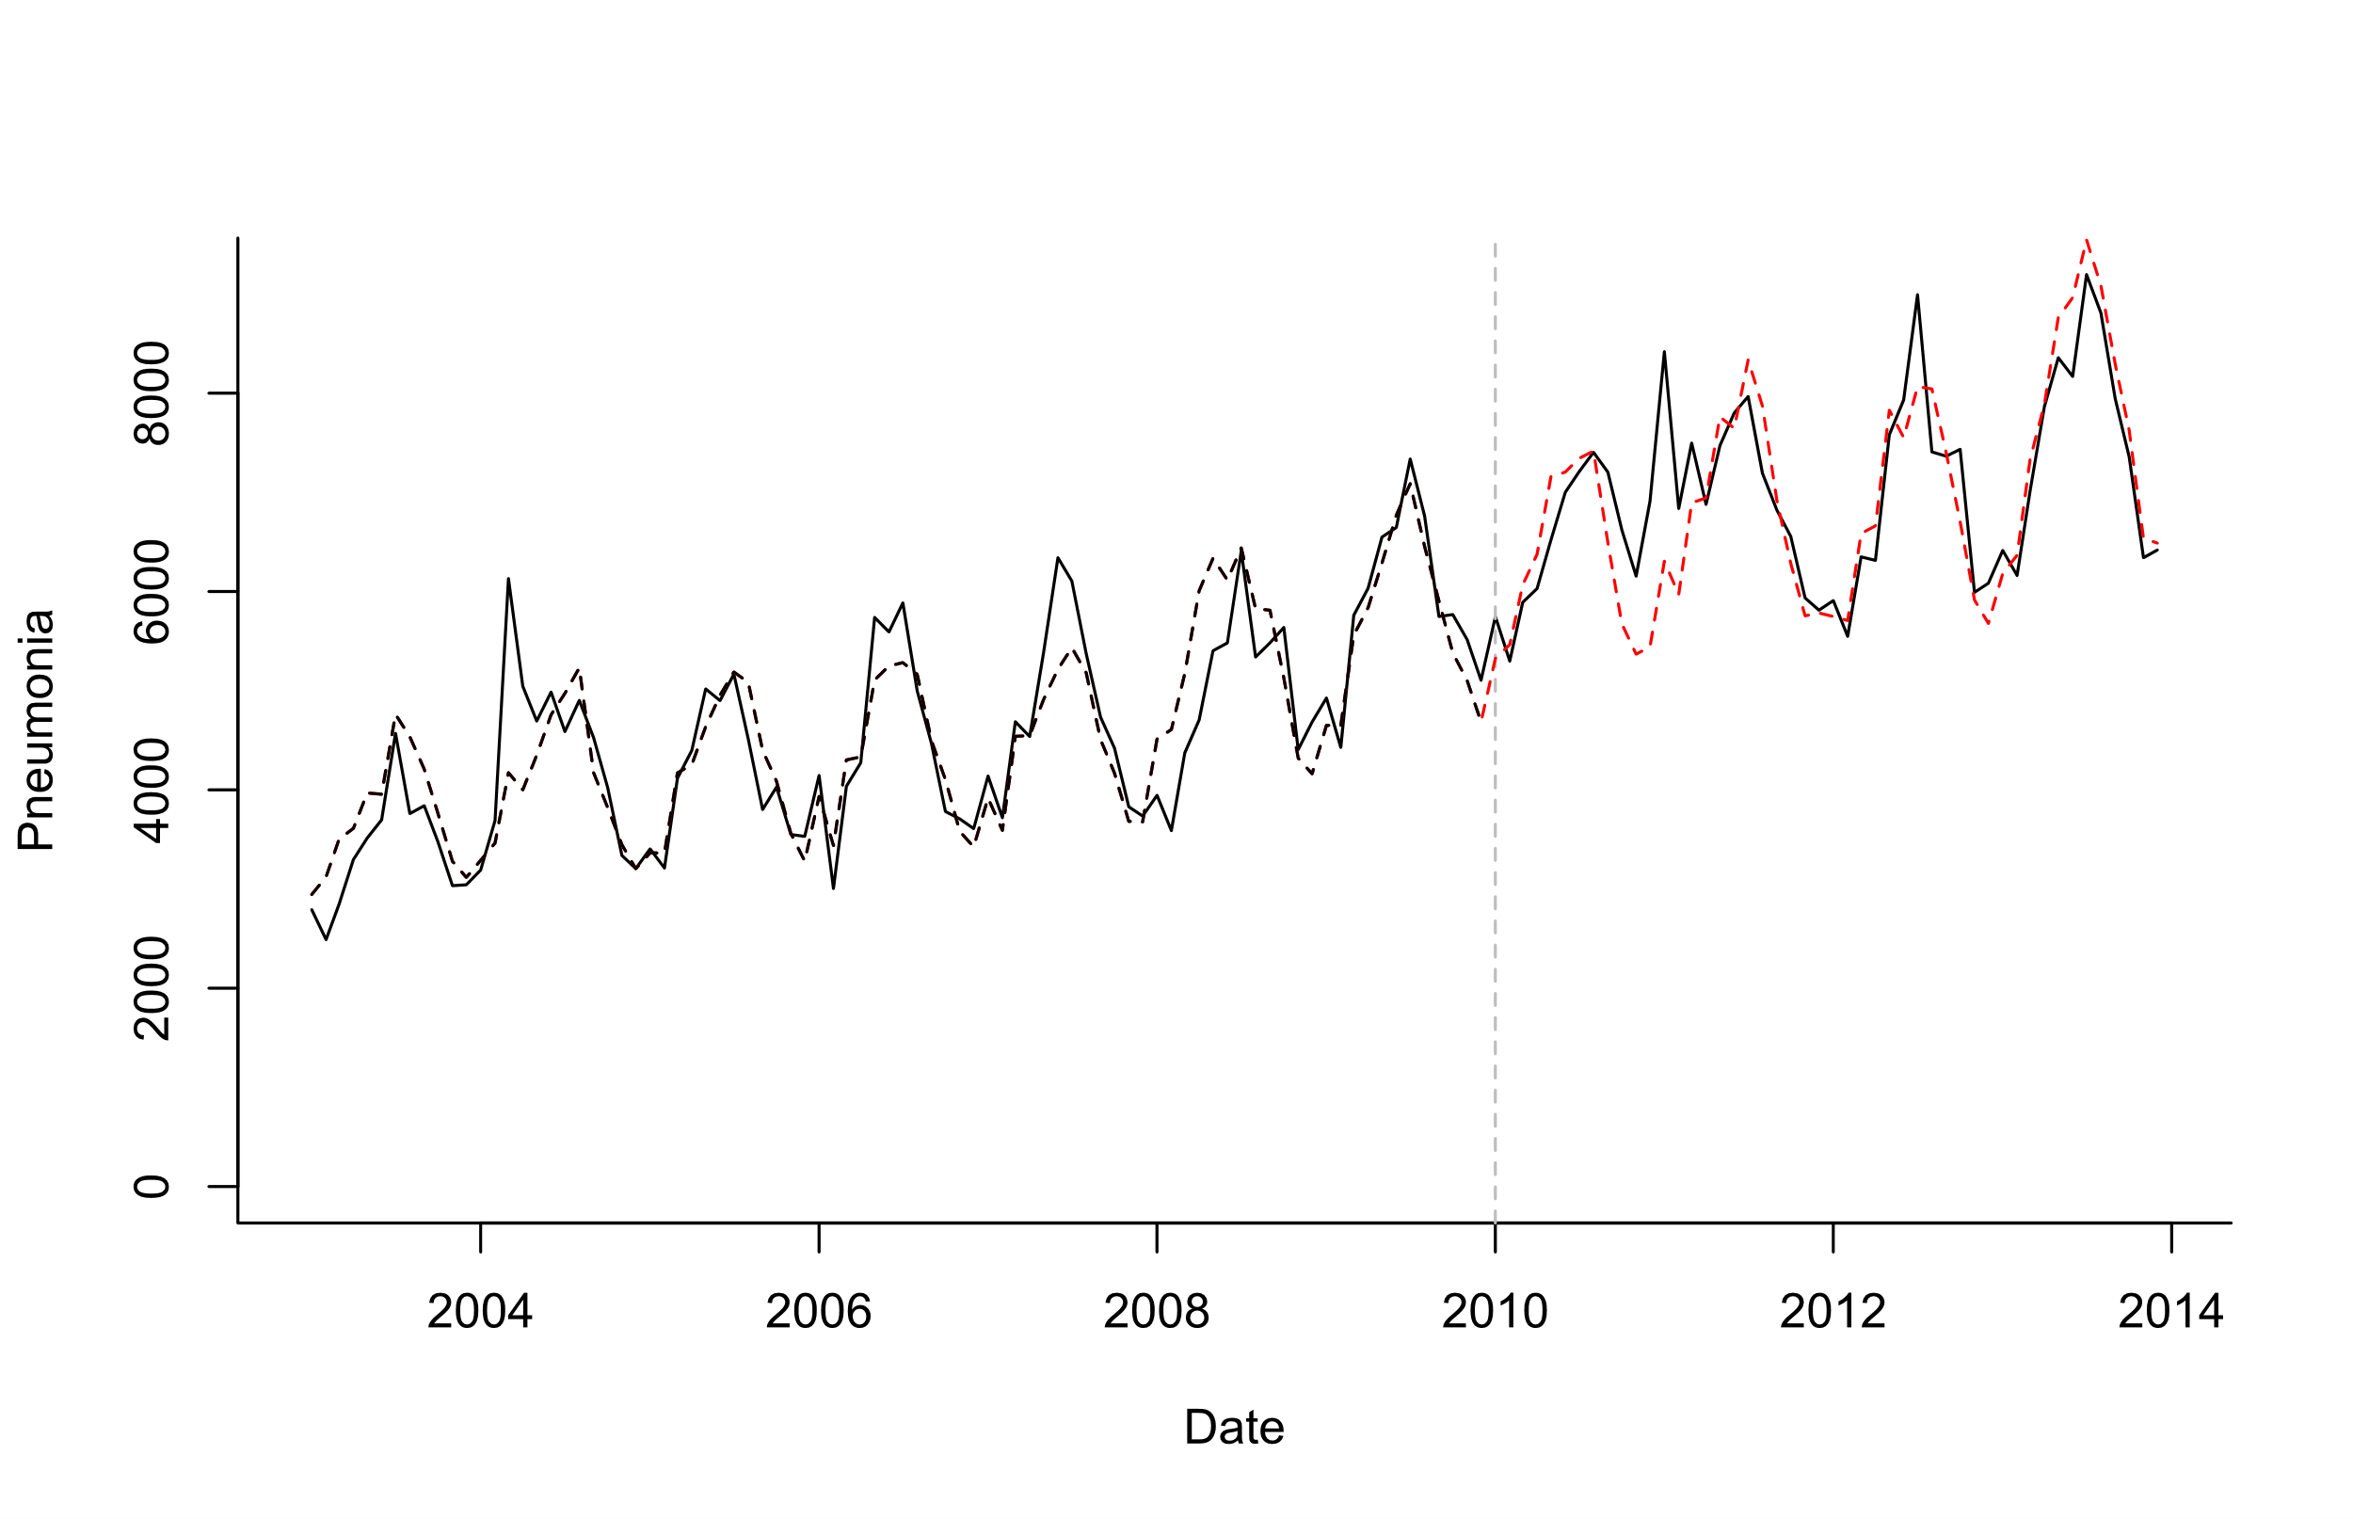
Use control disease as an adjustment variable
Log(Pneumonia)=b0 +b1*sin12 +b2*cos12 +b3*log(A10_B99)
Model Fitting
Extrapolation based on controls

Slide 67
What is a good control for pneumonia?

Slide 69
Principles for selecting candidate controls
Exclude any that could plausibly be influenced by the vaccine (e.g. pneumococcal/streptococcal septicemia)
Relationship should be stable over time except for intervention of interest (e.g. exclude diarrhea following rotavax)
Ideally would share some common causal factors
(Maybe exclude covariates with sparse data (<10 cases/month on average))

Slide 70
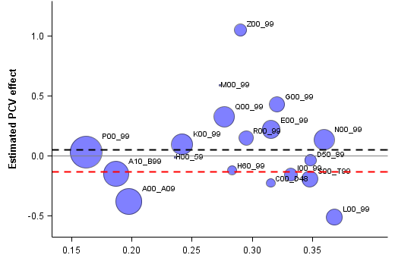
Perils of choosing a single control disease
Diseases of the genitourinary system (UTI)
Composite “PCV effect” on comparators
PCV effect on pneumonia
Diseases of the skin and subcutaneous tissue
More similar to all-cause pneumonia/ACH
**Choosing a single comparator/control is risky—composites are more robust

Slide 71
Letting the data select controls
Synthetic controls/CausalImpact method developed by Google for website analytics (Brodersen)
Select large number of candidate controls a priori
Use “automatic” Bayesian variable selection to give more or less weight to specific control diseases in the final model
Log(Pneumonia)=b0 +b1*sin12 +b2*cos12 +b3*control1+ b4*control2+ b5*control3…

Slide 72
What does synthetic controls do?
Outcome
(all-cause pneumonia hospitalizations)
ICD-10: J12-18
Control diseases
Various ICD-10 codes
34 diseases
(Children <12 mo in Brazil is used as an example)

Slide 73
What does synthetic controls do?
Fit regression model to pre-vaccine data only
Test different control variables alone or in combination
In forward or backward variable selection, you would drop less important variables
With this approach (Bayesian variable selection), you never drop any variables, you just give them more weight
Gives you a regression model with a set of controls that do the best job at explaining trends in pneumonia pre-PCV
Extrapolate to post-PCV period based on changes in the control variables

Slide 74
Components of the synthetic control model
Log(pneumonia cases_t)=b0+ sum(incl_i*b_i*log(control_i_t)) + sum(c_k*season_k)
Binary inclusion indicator for control series i
Time series for candidate control disease i
Monthly dummies to control for
Seasonality
“Spike and slab” prior for incl_i*b_i

Slide 75
Top control: B50-B89 (Protozoal diseases; Helminthiases; other infestations (could be linked to HIV)
Kleynhans, et al PLOS Medicine

Slide 76
Sensitivity analyses that are good to run
If have 6 years of pre-vaccine data, fit model to first 5 years, estimate “rate ratio” for 5th year
Should be ~1
Try dropping top 1,2,3 control variables; see if estimates change

Slide 77
Synthetic Controls: Pros and Cons
Provides flexible and robust approach to estimate vaccine impact
2 strong assumptions
None of the controls are influenced by the vaccine
The relationship between pneumonia and the controls does not change over time
Modifications needed for optimal use in small populations
Doesn’t guarantee you will detect/adjust for all confounding, but it increases the chances of success

Slide 78
What if we can’t identify appropriate controls because the data are too noisy?

Slide 79
Issues with Sparse Data
National:
PCV
Hard to assess correlations between the outcome and control diseases when data are noisy
Outcome
Controls
No. of cases (standardized, log)
SC model fails to select appropriate control disease(s) and generates unreliable prediction
What if we only observe 0.25% of cases? (ie small state in Brazil)
Outcome
Controls
No. of cases (standardized, log)
Notes:
A41: Other sepsis
I00_99: Diseases of the circulatory system

Slide 80
Solution: smooth the control diseases and use the smoothed summary in the model (STL+PCA)

Slide 81
Some guidelines
Using a control disease is critical
Avoid simple time trend adjustment
At a minimum, adjust for all-cause mortality/hospitalization
If at least 1 control disease identified, use the results from synthetic controls
If no control diseases identified, it is often because the data are too sparse: use sparse data approach (STL+PCA)

Slide 82
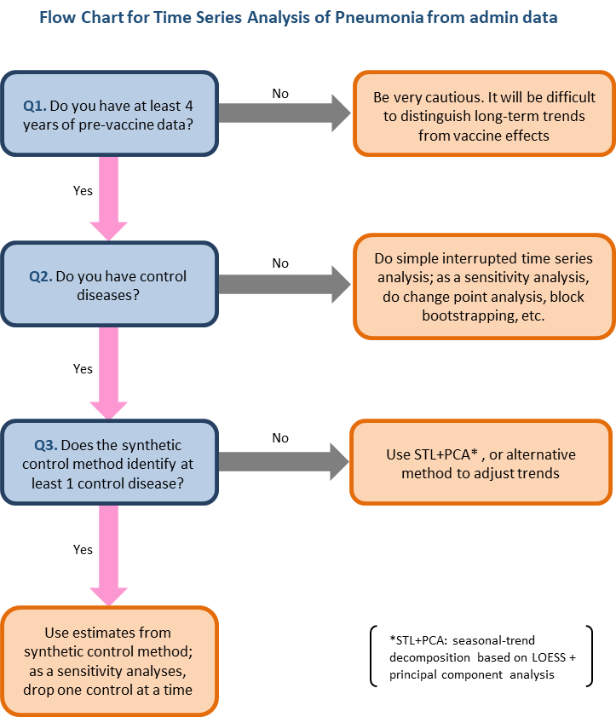
Kayoko Shioda, DVM, PhD MPH

Slide 83
Resources for using synthetic controls with administrative data
R package:
https://github.com/weinbergerlab/InterventionEvaluatR
Interface: dev.interventionevaluatr.com
Tutorial from Google
https://google.github.io/CausalImpact/CausalImpact.html
Original Google Paper
https://static.googleusercontent.com/media/research.google.com/en//pubs/archive/41854.pdf

